Slide 1
AESS
Explore the possibilites
Like the folder
Presented by: Sheila Ulrich, Director

Slide 2
OBJECTIVES
1. Explore Avera On-Line CNA Training Program
2. Demonstrate convenient access platform
3. Provide tools and resources to begin utilization

Slide 4
Why I am invested….
Born & raised in Northeast Nebraska
Married & relocated to AK for 8 years
Moved to Phoenix, AZ
Circled back to NE to raise kids
Passion was to return to healthcare 2015
Continue to see challenges with retaining staff and securing workforce.

Slide 5
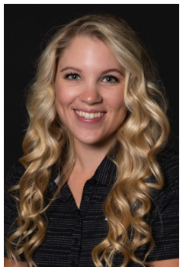
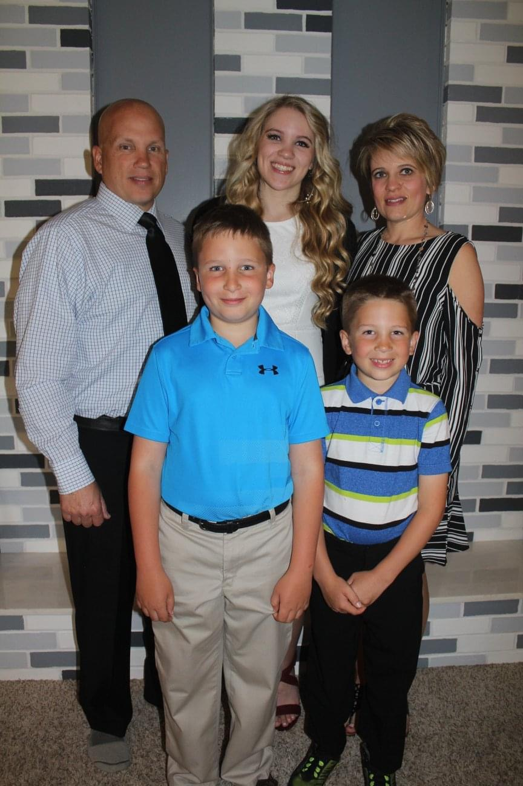
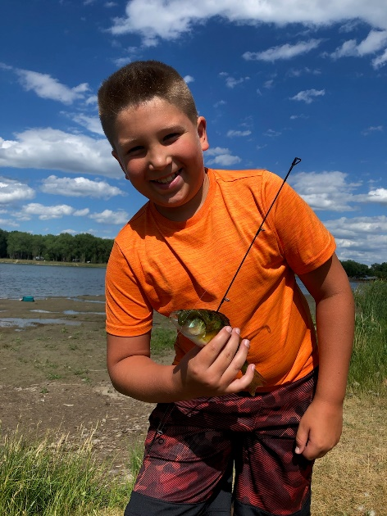
Why I am invested….

Slide 7
MODERN & CONVENIENT ACCESS
Access to averaeducation.org 24/7
Self-paced, review to re-enforce learning
Easy to register on-line
Questions available M-F
Developed and maintained in SD!

Slide 8
MODERN & CONVENIENT ACCESS
Registration of students
The Nursing Assistant 6th Edition
Skills Review (8 hours)
Supervised Practical Training (16 hours) completed on-site by RN, LPN or other supplemental trainer
Register to complete Nurse Aide Test
**more to follow on next webinar**

Slide 9
STEPS TO BEGIN PROGRAM:
Complete State and Federal applications
Include Resumes of instructors
Submit to Licensing Board—Dan Taylor
Once approved---begin registering students

Slide 10
AVERA EDUCATION WILL PROVIDE:
Syllabus
Training Documentation (report card)
Curriculum components
NE Abuse & Neglect (online)
Supplies & Equipment Listing
NE Skills Training Packet
Clinical Supervision Form

Slide 11
ADDITIONAL INFORMATION:
PASS/FAIL Rate= 99% for 2021
Skills Videos show all the steps to reinforce learning
Students enjoy working at their own pace
Quizzes add value to test learner throughout program

Slide 12
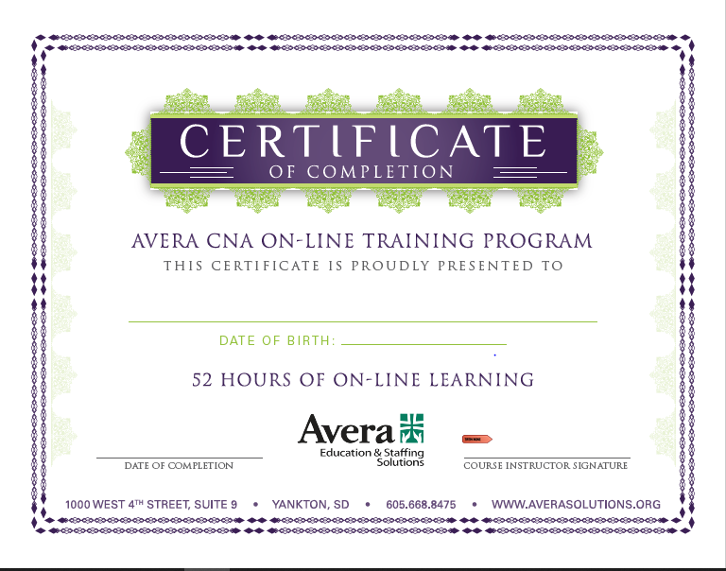

Slide 13
AVERA EDUCATION & STAFFING SOLUTIONS
1000 W. 4th Street, Suite 9
Yankton, SD 57078
(605)668-8475
Sheila.ulrich@avera.org
www.AveraSolutions.org www.AveraEducation.org

Slide 14
AESS
Explore the possibilites
Like the folder

